Slide 1
Thermal Balancing Policy for Streaming Computing on Multiprocessor Architectures
Annie Chen - 0111279

Slide 2
Introduction
Keep the spatial and temporal temperature gradient controlled for streaming computing MPSoC architecture.
Achieve thermal balancing with less cost in QoS by keeping task migration to a very low cost, both in performance and temperature.

Slide 3
Policy
A maximum distance of the temperature of each processor from the current average processor is defined.
Each time the temperature of a processor reaches the upper threshold, a migration is triggered so that a set of tasks is moved away from that processor to another processor having the temperature below the current average temperature.

Slide 4
Policy
The candidate processors(src and dst) are selected according to:
- (tsrc − tmean) ∗ (tdst − tmean) < 0
- (fsrc − fmean) ∗ (fdst − fmean) < 0
- (f²src + f²dst)before_migr ≥ (f²src + f²dst)after_migr

Slide 5
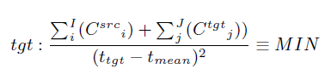
Policy
The selection of number of tasks and the final processor depends on the evaluation of migration costs.

Slide 6
Middleware support for task migration
task-replication: A replica of each task is present in each local OS and only one processor can run one replica of the task.
While a waste of memory for migratable tasks, task-replication has the advantage of being faster since it cuts down memory allocation time.

Slide 7
Experimental Results
Evaluating and comparing the following three policies:
- Energy-Balancing.
- Stop&Go.
- Migration-Based Thermal Balancing.

Slide 8
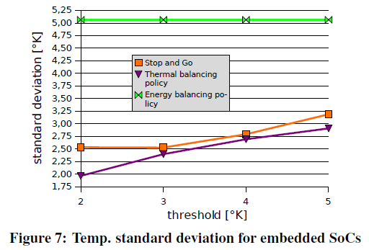
Policy evaluation and comparison – Mobile Embedded Targets

Slide 9
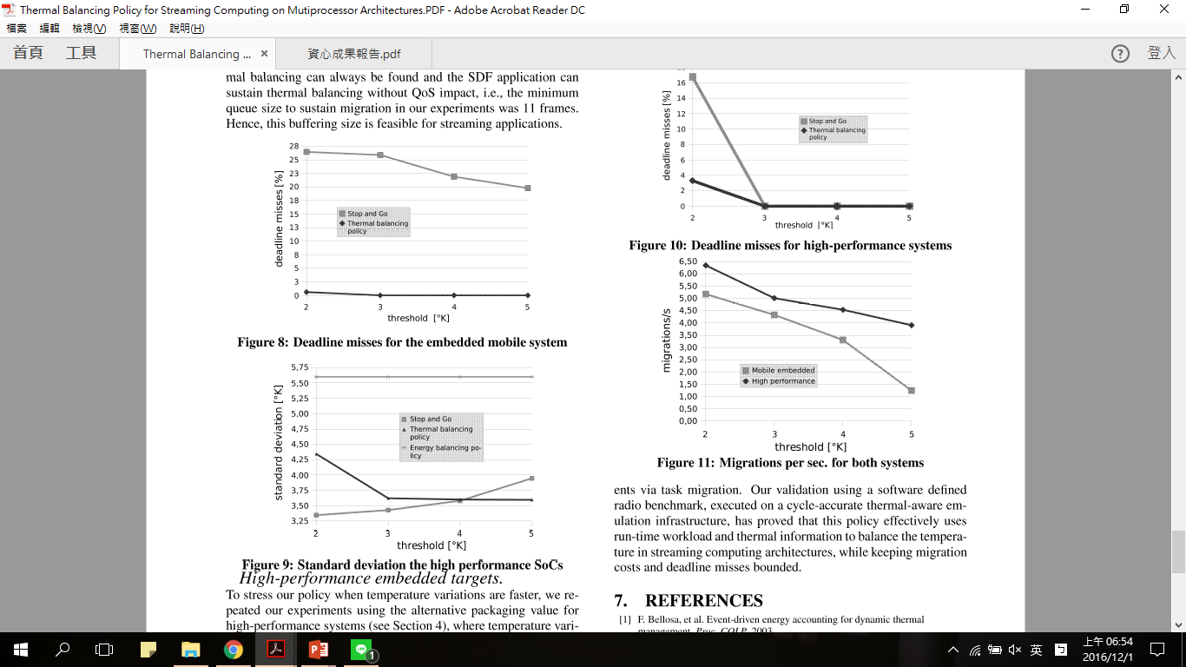
Policy evaluation and comparison – Mobile Embedded Targets

Slide 10
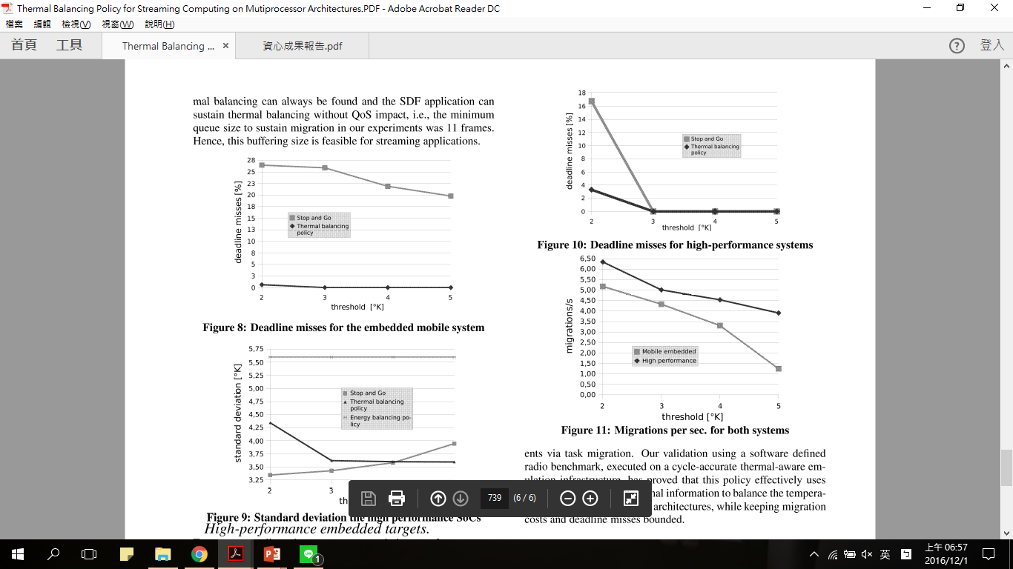
Policy evaluation and comparison – High-performance Embedded Targets

